Slide 1

DR. FAHEEM AKHTAR
Ph.D. (Zhejiang University)
Assistant Professor

Slide 2
What is Bias in Research?
Bias refers to errors or inaccuracies in the data collected. Bias could be introduced by the interviewer, the interviewee, or the situation.
The interviewer could bias the data if proper trust and rapport are not established with the interviewee, or when the responses are either misinterpreted or distorted, or when the interviewer unintentionally encourages or discourages certain types of response through gestures and facial expressions.

Slide 3
What is Bias in Research?
Interviewees can bias the data when they do not come out with their true opinions but provide information that they think is what the interviewer expects of them or would like to hear. Also, if they do not understand the
questions, they may feel diffident or hesitant to seek clarification. They may then answer questions without knowing their importance, and thus introduce bias.
Some interviewees may be turned off because of personal likes and dislikes, or the dress of the interviewer, or the manner in which the questions are put. They may, therefore, not provide truthful answers, but instead, deliberately offer incorrect responses. Some respondents may also answer questions in a socially acceptable manner rather than indicating their true sentiments.

Slide 4
What is Bias in Research?
Biases could be situational as well, in terms of (1) nonparticipants, (2) trust levels and rapport established, and (3) the physical setting of the interview. Nonparticipation, either because of unwillingness or the inability of the interviewee to participate in the study, can bias data inasmuch as the responses of the participants may be different from those of the nonparticipants (which implies that a biased, rather than a representative, set of responses is likely to result)
Bias also occurs when different interviewers establish different levels of trust and rapport with their interviewees, thus eliciting answers of varying degrees of openness. The actual setting in which the interview is conducted might sometimes introduce bias. Some individuals, for instance, may not feel quite at ease when interviewed at the workplace and therefore may not respond frankly and honestly

Slide 5
How to avoid bias in research (Establishing credibility and rapport, and motivating individuals to respond)
Researcher's Demeanor
To be hired and gain credibility, a researcher must project professionalism, enthusiasm, and confidence.
They need to demonstrate knowledge, skills, ability, articulateness, and enthusiasm to establish credibility with the hiring organization.

Slide 6
How to avoid bias in research (Establishing credibility and rapport, and motivating individuals to respond)
Building Rapport and Trust
The primary goal is to make respondents feel sufficiently at ease to give honest, informative, and truthful answers.
This is achieved by:
Clearly stating the purpose of the interview.
Assuring complete confidentiality of their responses.
Being pleasant, sincere, sensitive, and nonevaluative.
Showing genuine interest in their answers.
Allaying any anxieties, fears, suspicions, and tensions.

Slide 7
How to avoid bias in research (Establishing credibility and rapport, and motivating individuals to respond)
Overcoming Suspicion (Especially with Lower-Level Employees)
Employees may be suspicious, believing researchers are on management's "side" and could lead to negative outcomes like layoffs or increased workload.
To counter this, researchers must:
Clarify that their purpose is only to understand the true state of affairs.
Convince respondents that they do not intend to take sides or cause harm.
Explain that results will be reported only in aggregate, without disclosing individual identities.

Slide 8
How to avoid bias in research (Establishing credibility and rapport, and motivating individuals to respond)
Motivating Honest Participation
Researchers can motivate respondents by:
Explaining how their contribution will help the organization.
Stating that they may personally gain from the survey through an improved quality of work life.
Informing them why they were chosen for the interview to foster better communication.

Slide 9
How to avoid bias in research (Effective Questioning Techniques
Funneling: At the beginning of an unstructured interview, it is advisable to ask open‐ended questions to get a broad idea and form some impressions about the situation. For example, a question that could be asked would be:
What are some of your feelings about working for this organization?
From the responses to this broad question, further questions that are progressively more focused may be asked as the researcher processes the interviewees’ responses and notes some possible key issues relevant to the situation. This transition from broad to narrow themes is called the funneling technique.

Slide 10
How to avoid bias in research (Effective Questioning Techniques
Unbiased questions: It is important to ask unbiased questions to ensure that you minimize bias in the responses.
For example, “Tell me how you experience your job” is a better question than, “Boy, the work you do must be really boring; let me hear how you experience it.” The latter question is “loaded” in terms of the interviewer’s own perceptions of the job. A loaded question might influence the types of answers received from the respondent. Bias could also be introduced by emphasizing certain words, by tone and voice inflections, and through inappropriate suggestions.

Slide 11
How to avoid bias in research (Effective Questioning Techniques
Clarifying issues: To ensure the researcher accurately understands the respondent’s views, it is helpful to restate or rephrase key points.
For example, if a respondent says, “Promotions here are unfair; juniors always get promoted,” the researcher might reply, “So you mean capable seniors are overlooked for promotion?”—this helps confirm meaning.
Similarly, if a respondent says, “The facilities are poor; we work even when dying of thirst,” the researcher could ask whether drinking water is available. Clarifying questions like these help prevent misunderstandings and ensure accurate interpretation.

Slide 12
How to avoid bias in research (Effective Questioning Techniques
Helping the respondent to think through issues: If the respondent is not able to verbalize her perceptions, or replies, “I don’t know,” the researcher should ask the question in a simpler way or rephrase it.
For instance, if a respondent is unable to specify what aspects of the job he dislikes, the researcher might ask the question in a simpler way. For example, the respondent might be asked which task he would prefer to do: serve a customer or do some filing work. If the answer is “serve the customer,” the researcher might use another aspect of the respondent’s job and ask the paired‐choice question again. In this way, the respondent can sort out which aspects of the job he likes better than others.

Slide 13
How to avoid bias in research (Effective Questioning Techniques
Taking notes: During interviews, researchers should take written notes immediately rather than relying on memory, as recalled information can be inaccurate and confusing, especially after multiple interviews. Relying on memory may also introduce bias. Interviews can be audio-recorded if participants agree, but recordings may influence responses since participants know they are being recorded. Therefore, researchers should ensure that recording will not bias the data and must always get the respondent’s permission before doing so.

Slide 14
TYPES OF VARIABLES
Variable
- Any characteristic which is subject to change and can have more than one value such as age, intelligence, motivation, gender, etc.
- Variables are “changing qualities or characteristics” of persons or things like age, gender, intelligence, ideas, achievements, confidence, and so on that are involved in your research study.

Slide 15
BASIC TYPES
Dependent Variables – DV
The dependent variable is the variable of primary interest to the researcher. The researcher’s goal is to understand and describe the dependent variable, or to explain its variability, or predict it. In other words, it is the main variable that lends itself for investigation as a viable factor. Through the analysis of the dependent variable (i.e., finding what variables influence it), it is possible to find answers or solutions to the problem.
• Variable affected by the independent variable
• It responds to the independent variable.

Slide 16
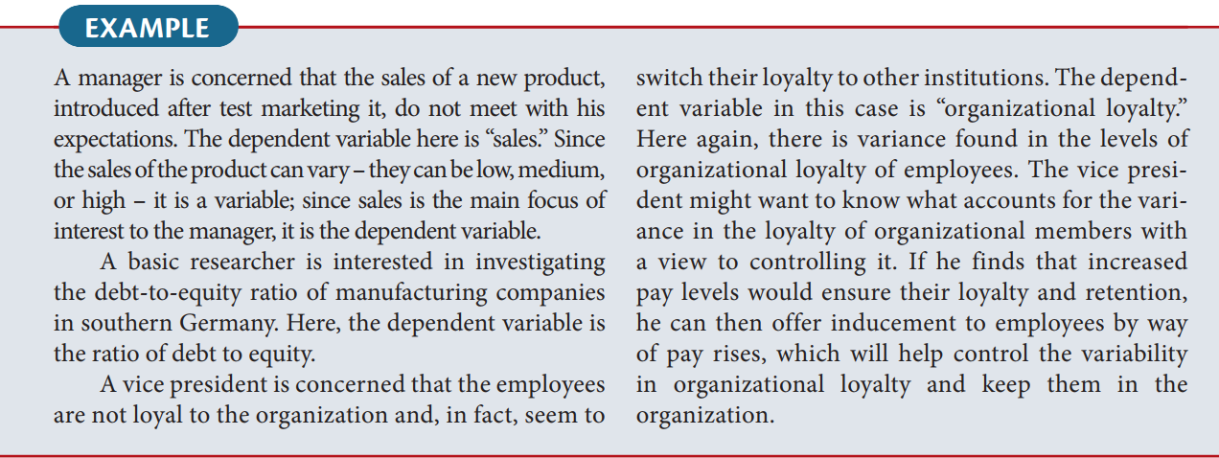
BASIC TYPES

Slide 17

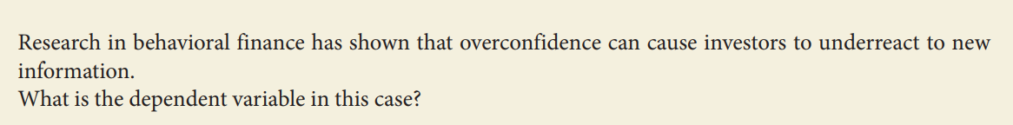
BASIC TYPES

Slide 18
BASIC TYPES
2. Independent Variables – IV
Independent variable is one that influences the dependent variable in either a positive or negative way. That is, when the independent variable is present, the dependent variable is also present, and with each unit of increase in the independent variable, there is an increase or decrease in the dependent variable. In other words, the variance in the dependent variable is accounted for by the independent variable.
• Variable that is presumed to influence other variable.
• It is the presumed cause, whereas the dependent variable is the presumed effect.

Slide 19
BASIC TYPES
To establish that a change in the independent variable causes a change in the dependent variable, four conditions should be met:
1. The independent and the dependent variable should covary: in other words, a change in the dependent variable should be associated with a change in the independent variable.
Example:
Let’s say you are studying the relationship between study time (independent variable) and exam score (dependent variable).
When students increase their study time, their exam scores go up.
When students study less, their exam scores drop.
This shows covariation — changes in the independent variable (study time) are associated with changes in the dependent variable (exam score).

Slide 20
BASIC TYPES
2. The independent variable (the presumed causal factor) should precede the dependent variable. In other words, there must be a time sequence in which the two occur: the cause must occur before the effect.
Example:
Suppose a researcher wants to study whether training programs (independent variable) improve employee performance (dependent variable).
First, the organization conducts the training program.
After the training, the researcher measures employee performance through evaluations or productivity levels.
If the improvement in performance happens after the training, it suggests that the cause (training) came before the effect (better performance).

Slide 21
BASIC TYPES
3. No other factor should be a possible cause of the change in the dependent variable. Hence, the researcher should control for the effects of other variables.
Example:
A researcher wants to find out whether exercise (independent variable) causes weight loss (dependent variable).
However, other factors, such as diet, sleep, or metabolism — can also affect weight loss. To make sure that exercise is the real cause, the researcher must control these other variables.
Example:
All participants follow the same diet.
They get similar amounts of sleep.
The study lasts for the same duration for everyone.
After controlling these factors, if those who exercise more still lose more weight, it supports the conclusion that exercise, not diet or sleep, caused the weight loss.

Slide 22
BASIC TYPES
4. A logical explanation (a theory) is needed and it must explain why the independent variable affects the dependent variable
Example:
A researcher studies how employee motivation (independent variable) affects job performance (dependent variable).
To justify this relationship, a logical explanation or theory is needed, for instance, Self-Determination Theory (SDT).
According to SDT, when employees feel motivated because their work satisfies needs for autonomy, competence, and relatedness, they become more engaged and perform better.
So, the theory explains why motivation leads to higher performance:
Motivation → increases effort, focus, and persistence → leads to better job performance.

Slide 23
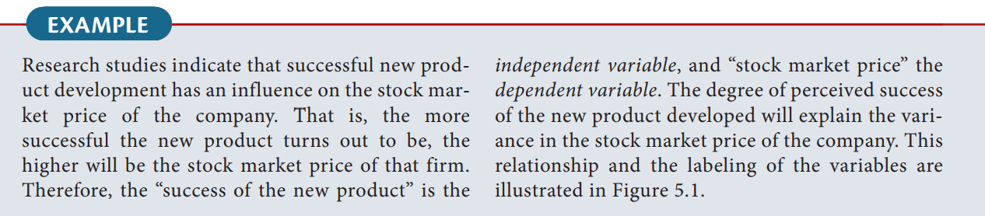
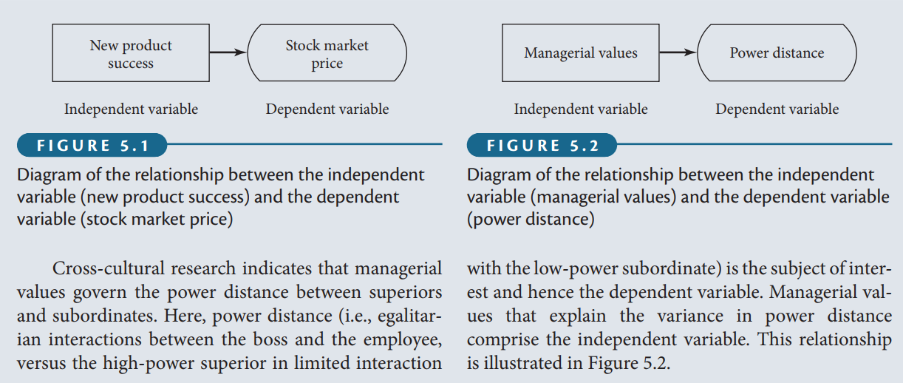
BASIC TYPES

Slide 24
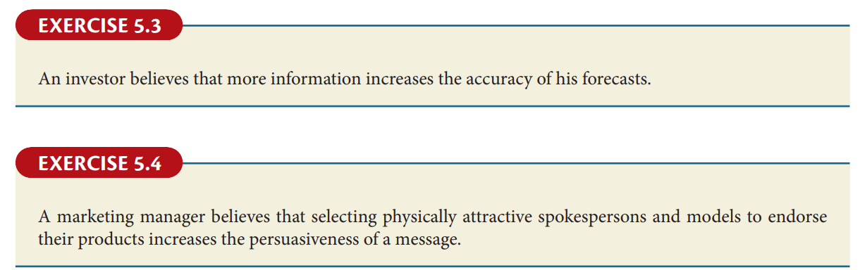
BASIC TYPES

Slide 25
BASIC TYPES
Other Names
Dependent Variable | Independent Variable
Explained | Explanatory
Predictand | Predictor
Regressand | Regressor
Response | Stimulus
Outcome | Covariate

Slide 26
BASIC TYPES
Test Your Understanding.
For each question, choose the dependent variable. A tip for completing: First choose the two main variables from the statement. Then figure out which one is the DV (it’s the one that depends on the other one).
Q1: You are conducting an experiment to see if exposure to more sunlight increases happiness levels for workers who typically spend the entire day in windowless offices.
Sunlight
Happiness level
Windowless offices
Time of day.

Slide 27
BASIC TYPES
Q2: An experiment in a climate-controlled greenhouse concludes that water level, fertilizer and nutrient level in soil affects how tall plants grow. Plants grew an average of 12″ taller if treated with optimal resources.
The greenhouse
Water level, fertilizer and nutrient levels
How tall the plants grow
Optimal resources.

Slide 28
BASIC TYPES
Q3: A researcher suspects that a cholera outbreak is happening because of tainted wells in the city. Most of the cases are clustered around public wells that draw their water from the underground aquifer.
The underground aquifer
Cholera
Wells
The City

Slide 29
BASIC TYPES
Q4: Studies have shown that regular vaccination is effective in controlling the spread of influenza. However, studies also show that a combination of two antiviral medications (oseltamivir and zanamivir) can also control the spread of the disease.
Oseltamivir
Zanamivir
Both 1 and 2
Influenza

Slide 30
BASIC TYPES
Q5: Researchers investigated whether the introduction of a carbon taxation policy reduces national carbon emissions through changes in industrial energy consumption behavior. The study compared countries with and without carbon taxes over a 10-year period.
Carbon taxation policy
Industrial energy consumption behavior
National carbon emissions
Countries

Slide 31
BASIC TYPES
Moderating variable:
The moderating variable is one that has a strong contingent effect on the independent variable–dependent variable relationship. That is, the presence of a third variable (the moderating variable) modifies the original relationship between the independent and the dependent variables.
So, whenever the relationship between the independent variable and the dependent variable becomes contingent or dependent on another variable, we say that the third variable has a moderating effect on the independent variable–dependent variable relationship. The variable that moderates the relationship is known as the moderating variable.

Slide 32
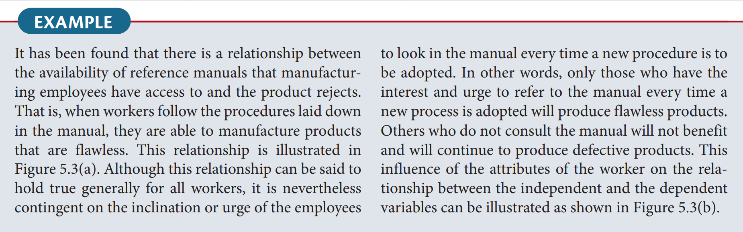
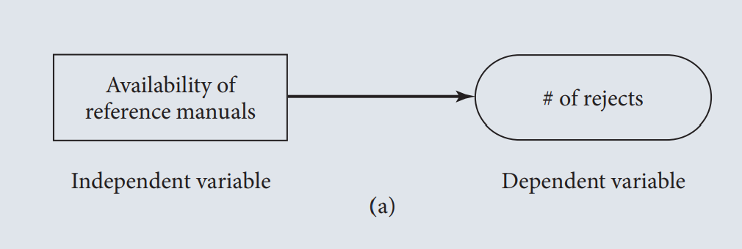
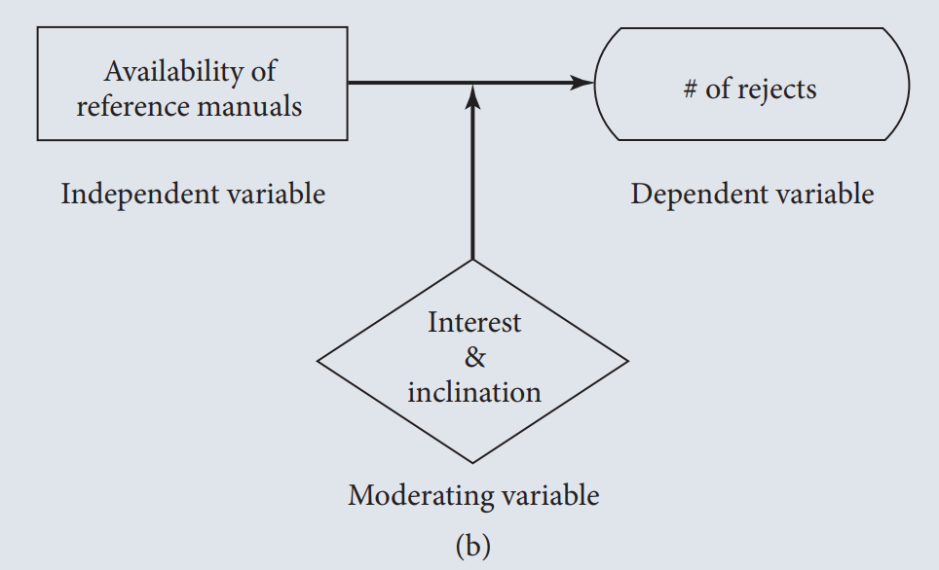
BASIC TYPES

Slide 33
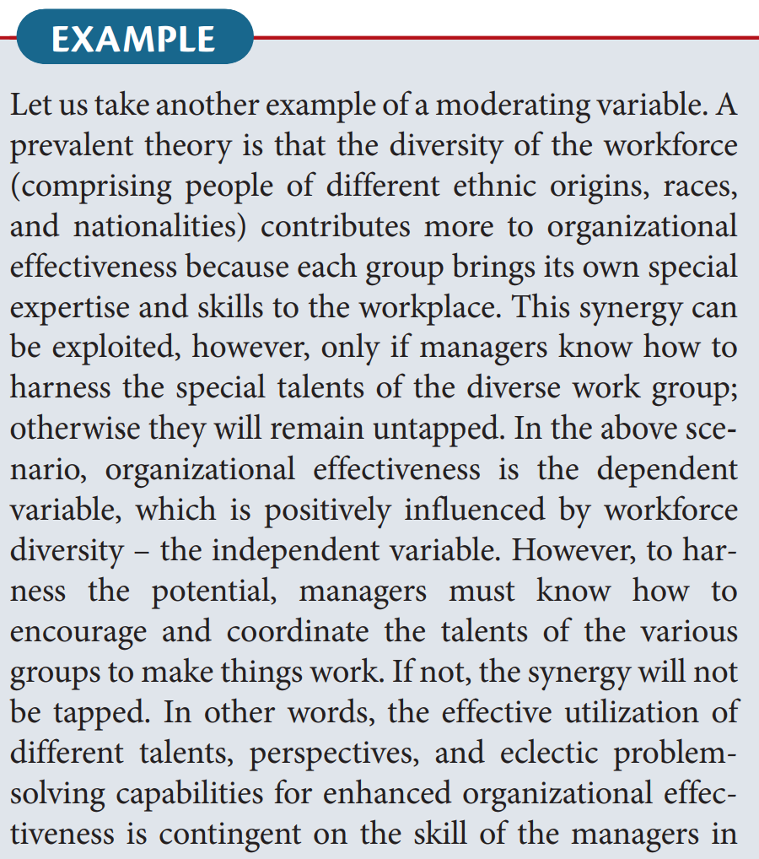
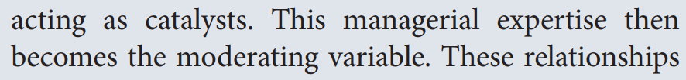

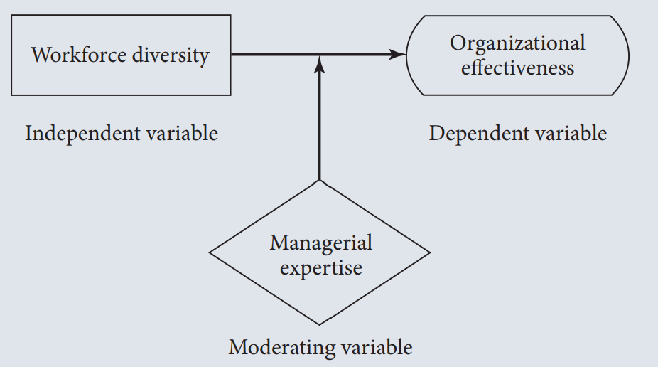

Slide 34
BASIC TYPES
Mediating variable:
A mediating (or intervening) variable is a factor that comes into effect between the independent and dependent variables, showing how or why the independent variable influences the outcome. It represents a process that unfolds over time: first, the independent variable affects the mediator, and then the mediator impacts the dependent variable. In simple terms, a mediating variable helps explain the connection or pathway through which one variable influences another.

Slide 35
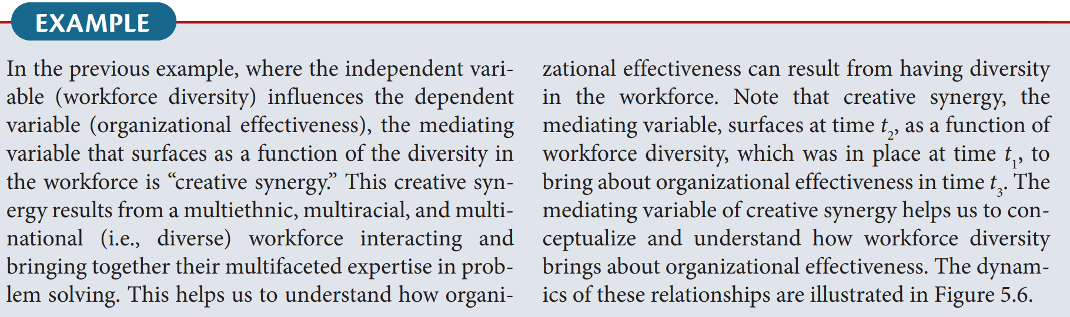
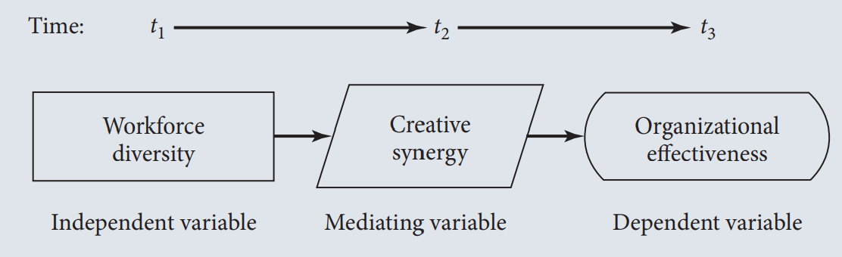

Slide 36
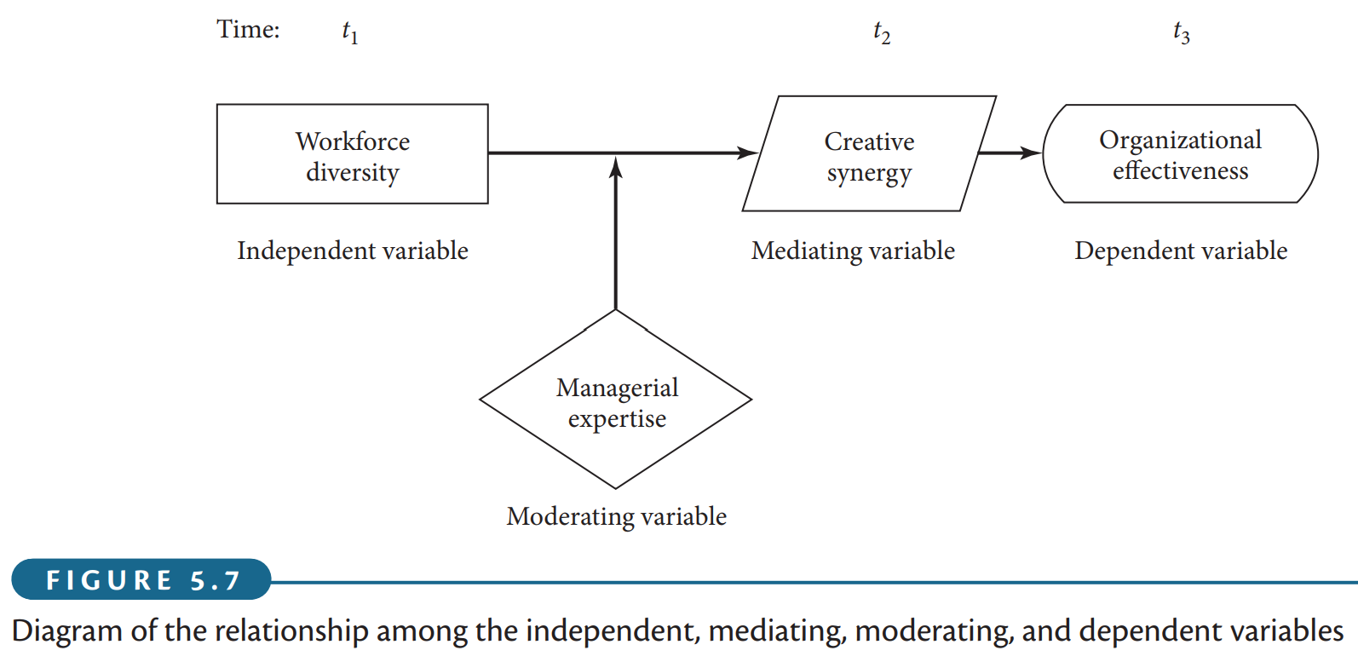
How the inclusion of the moderating variable, “managerial expertise” in the foregoing example, would change the model or affect the relationships. The new set of relationships that would emerge in the presence of the moderator is depicted in Figure 5.7. As can be seen, managerial expertise moderates the relationship between workforce diversity and creative synergy. In other words, creative synergy will not result from the multifaceted problem‐solving skills of the diverse workforce unless the manager is capable of harnessing that synergy by creatively coordinating the different skills. If the manager lacks the expertise to perform this role, then no matter how many different problem‐solving skills the diverse workforce might have, synergy will just not surface. Instead of functioning effectively, the organization might just remain static, or even deteriorate.

Slide 37
It is now easy to see what the differences are among an independent variable, a mediating variable, and a moderating variable. The independent variable helps to explain the variance in the dependent variable; the mediating variable surfaces at time t₂ as a function of the independent variable, which also helps us to conceptualize the relationship between the independent and dependent variables; and the moderating variable has a contingent effect on the relationship between two variables. To put it differently, while the independent variable explains the variance in the dependent variable, the mediating variable does not add to the variance already explained by the independent variable, whereas the moderating variable has an interaction effect with the independent variable in explaining the variance. That is, unless the moderating variable is present, the theorized relationship between the other two variables considered will not hold.

Slide 38
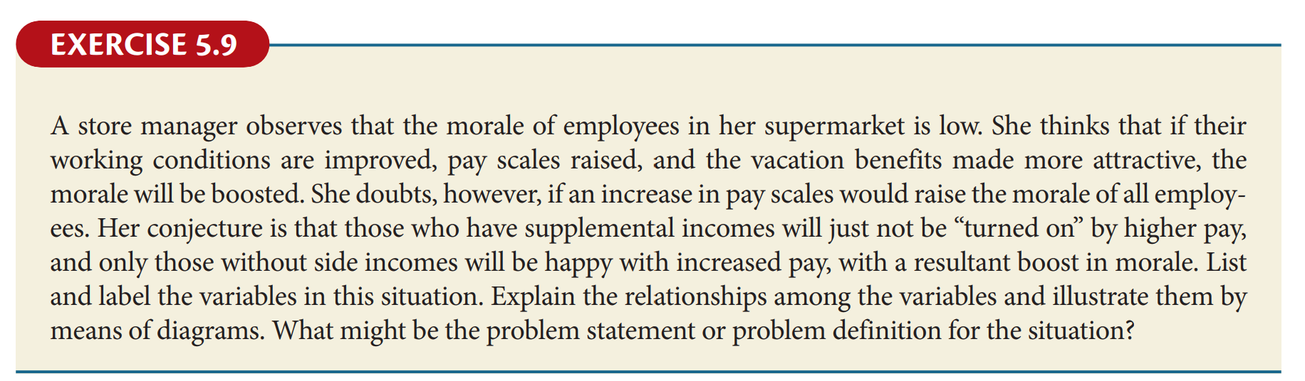
Problem Statement or Problem Definition: To investigate the factors that influence employee morale in a supermarket setting, specifically examining the effects of improved working conditions, increased pay scales, and enhanced vacation benefits. Additionally, to determine whether the presence of supplemental income among employees moderates the relationship between pay scales and morale, thereby identifying targeted strategies to effectively boost morale across different employee groups.
Dependent Variable: Employee morale,
Independent Variables: pay scale
Moderating Variable: Supplemental income
Pay Scales
Employee Morale
Supplemental Income

Slide 39
Individual Activity:
Write your research title and
determine your variables. What might be the problem statement or problem definition for the situation?

Slide 40
Thanks

